Slide 1

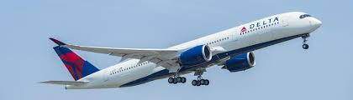

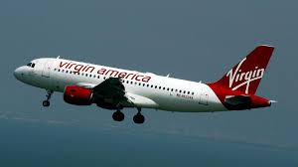
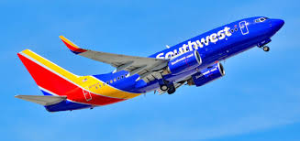
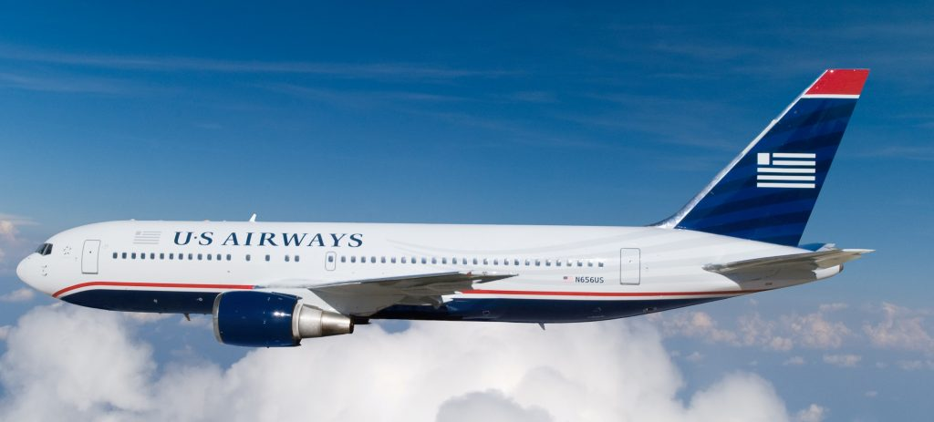

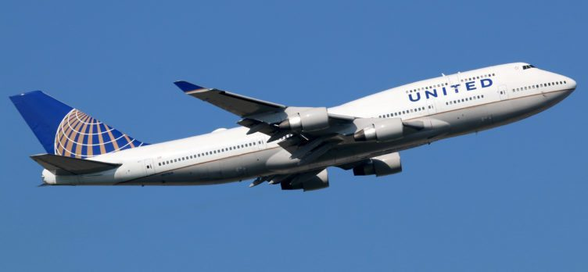
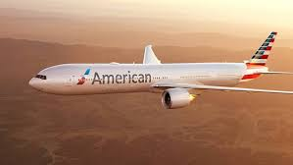
Twitter US Airline Sentiment analysis
Minakshi Kesarwani

Slide 2
Project Goal
To build a machine learning model that can predict the negative and positive sentiment of tweets relating to US airlines
To analyze negative tweets and find out negative reasons which made travelers angry
To Create word vector which represents sentiment of tweets
To design a machine learning algorithm which can provide better accuracy, F1 score, AUC score

Slide 3
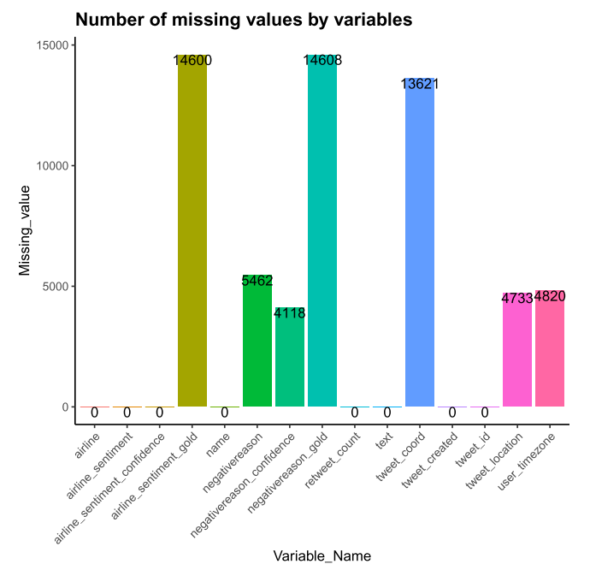
Dataset Review
Source | About | Tweets | Timeline | Sentiments | Airline
Kaggle | Airline travelers tweet analysis | 14640,15 | February,2015 (~one week) | Negative, Neutral, Positive | 6 Airlines (Delta, United, Southwest, Virgin America, US airways, American)
Attributes in dataset
1) tweet_id 2)airline_sentiment
3)airline_sentiment_confidence 4)negativereason
5)negativereason_confidence 6)airline 7)airline_sentiment_gold 8)name
9)negativereason_gold 10)retweet_count
11)Text 12)tweet_coord
13)tweet_created 14)tweet_location
15)user_timezone

Slide 4
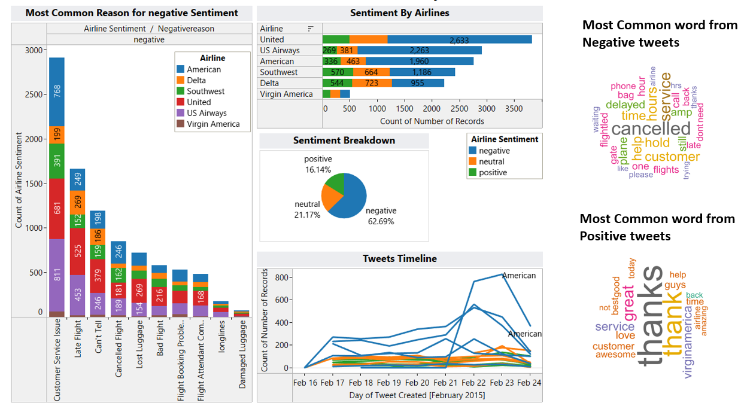
Sentiment Analysis Dashboard

Slide 5
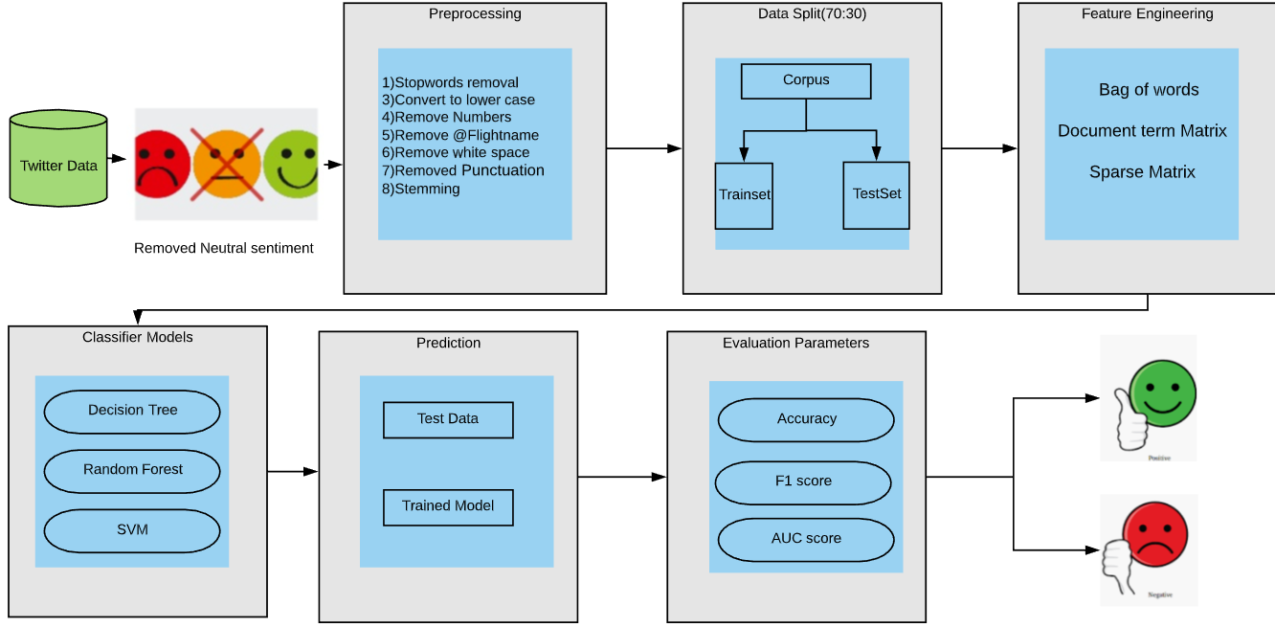
Workflow diagram

Slide 6
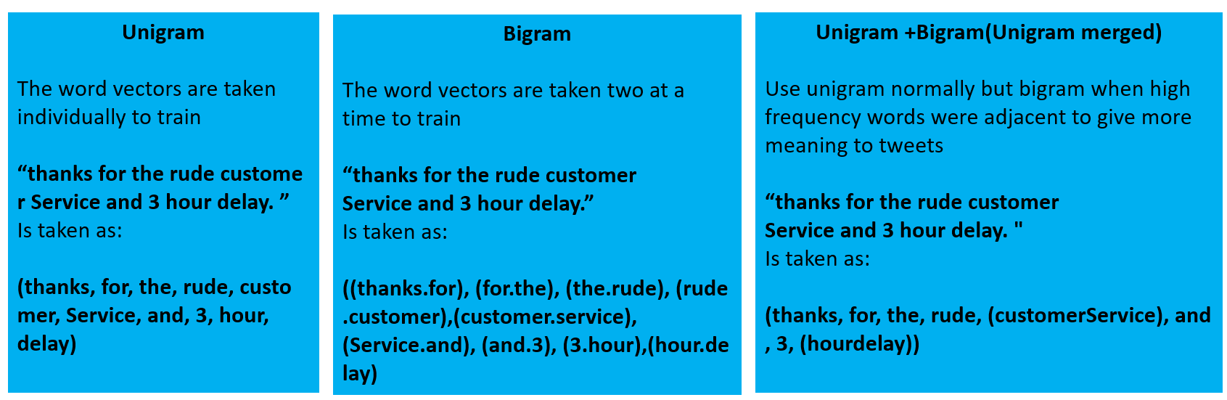
Methodology adopted for tweets classification
Language Model
Test Accuracy Result
Classification Model
Model | Unigram(Unmerged) | Bigram(Unmerged) | Unigram | Bigram
Decision Tree | 0.84 | 0.75 | 0.86 | 0.78
Decision Tree
Random Forest
SVM Kernel Linear

Slide 7
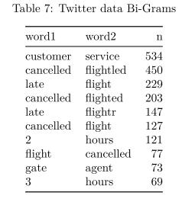
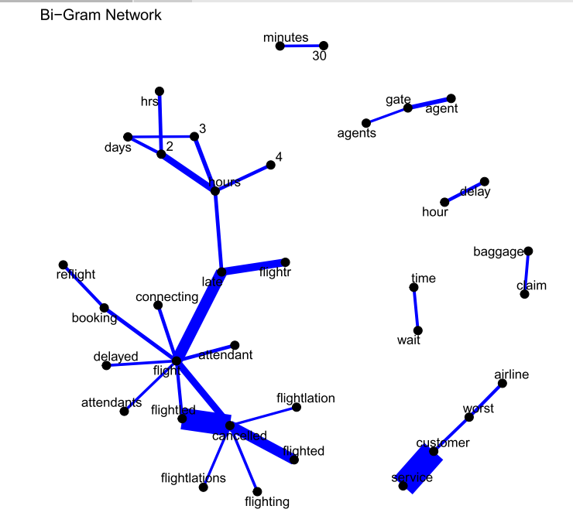
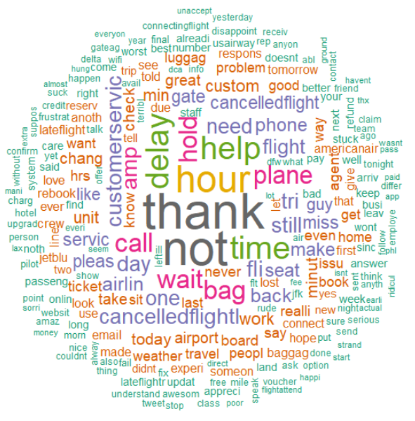
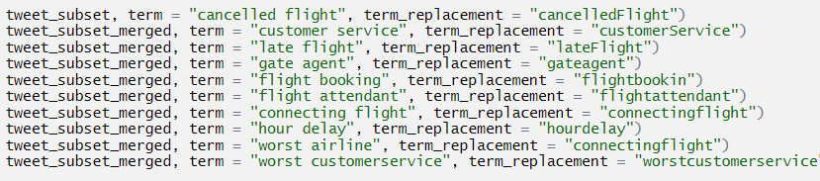
Bigram network visualization
Corpus word cloud
Merged word in corpus

Slide 8
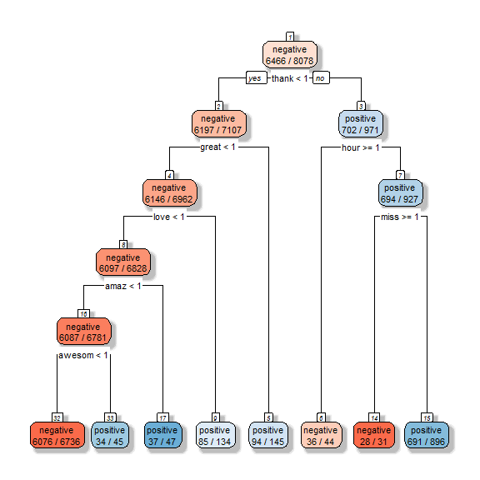
Decision tree

Slide 9
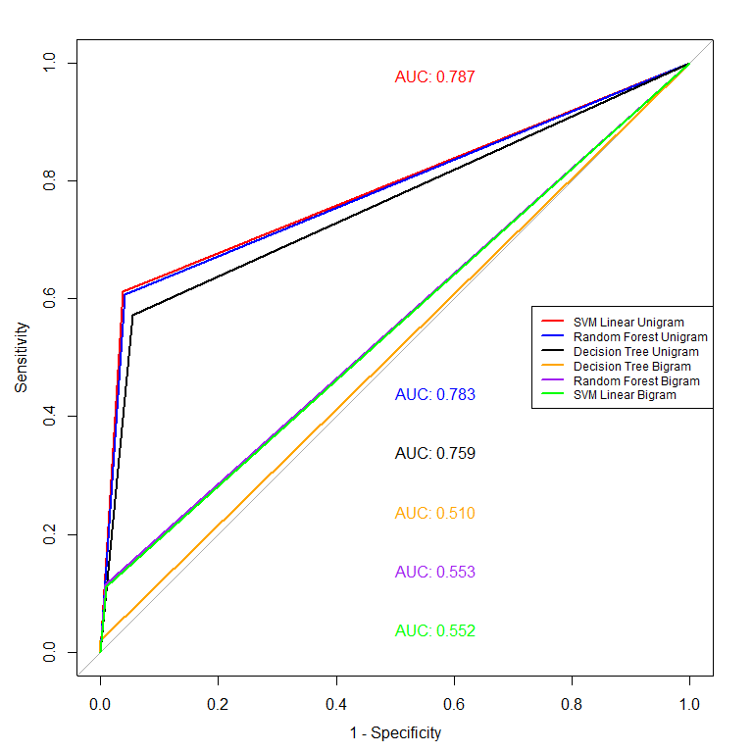
Result and Conclusion
ROC Plot
Model Comparison
Model | Test Accuracy(%) | Train Accuracy(%) | F1 score | AUC
SVM Linear Unigram | 88.7 | 90.8 | 93.0 | 78.8
Random Forest Unigram | 88.3 | 94.7 | 92.8 | 78.3
Decision Tree Unigram | 86.5 | 87.7 | 91.6 | 75.9
Decision Tree Bigram | 78.7 | 80.3 | 88.0 | 51.0
Random Forest Bigram | 80.2 | 81.9 | 88.7 | 55.3
SVM Linear Bigram | 80.0 | 82.1 | 88.6 | 55.1

Slide 10


